Slide 1
EMR Training:
Documents
Last updated: Mar 31, 2012

Slide 2
Documents
Scanning documents
Viewing documents
Tagging and assigning documents
Fixing errors
Advanced

Slide 3
Scanning Documents
Using your installed scanner software, scan your document into PDF
Save the PDF to your hard drive

Slide 4
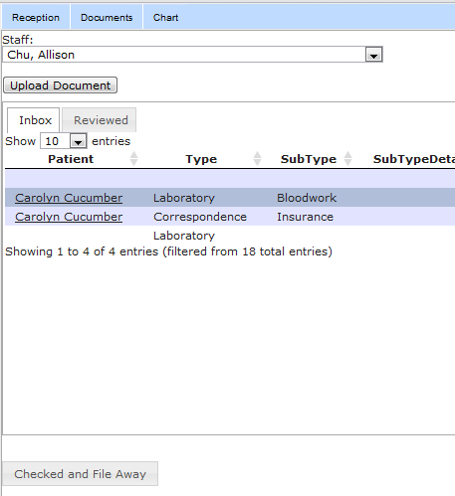
Uploading Documents to EMR
Go to Documents Tab
Select yourself as staff member
Your document inbox is here

Slide 5
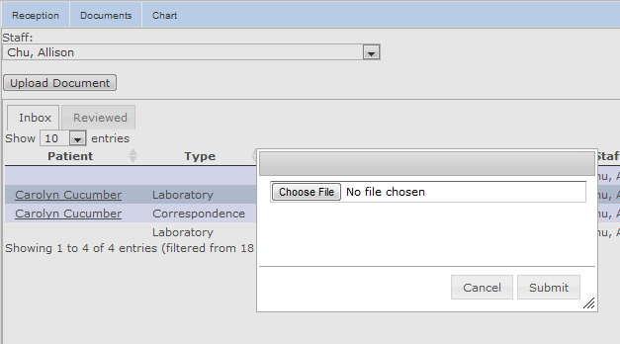
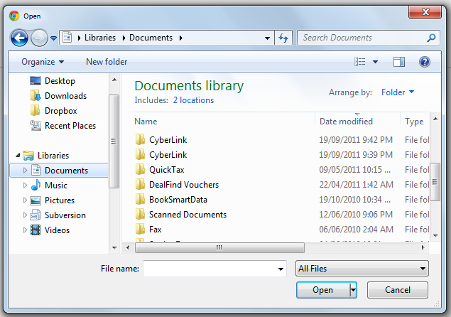
Uploading Documents to EMR
Click “Upload Document”
Click “Choose File”
Browse to your PDF

Slide 6
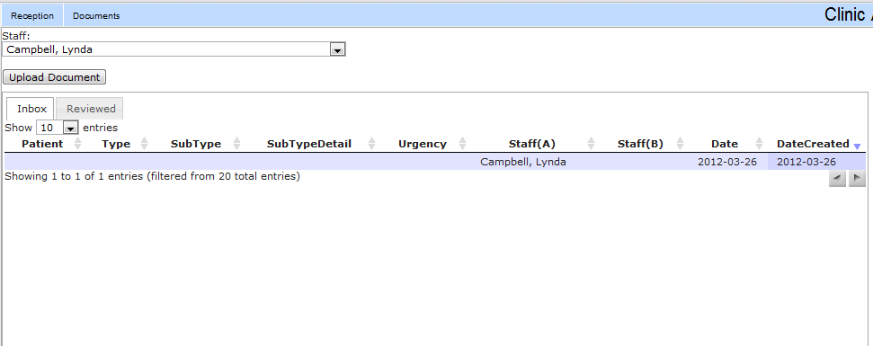
Uploading Documents to EMR
After you click submit, your uploaded document should appear in your inbox

Slide 7
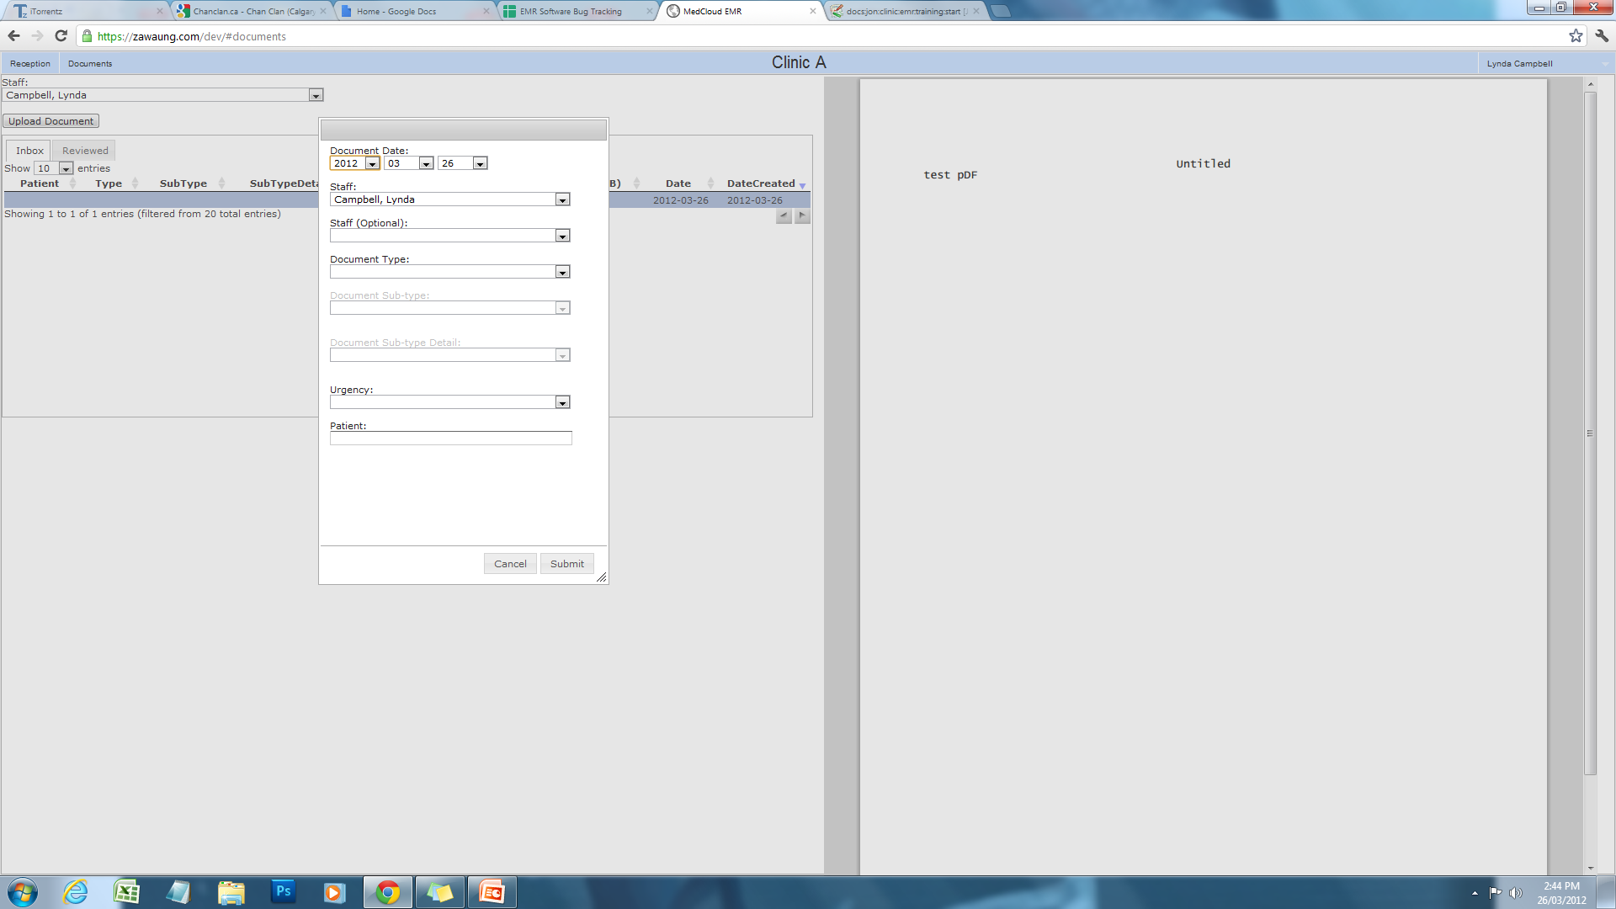
Previewing and Tagging
Single click on the uploaded document in your inbox to see a preview on the right side
Double click it to tag and assign
it to a staff member for review

Slide 8
Tagging
Select the date of the document
Select a staff member to assign for review
Select the document type from the drop down box

Slide 9
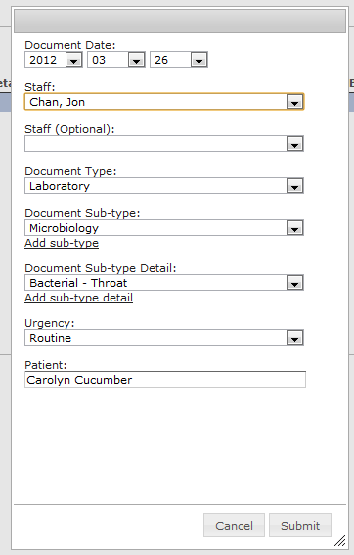
Tagging
If the type you selected has predefined subtypes, you can select the subtype from the next drop down menu
Select an urgency
Select the patient

Slide 10
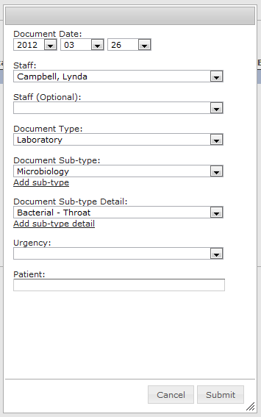
Assigning
Review your changes and click Submit
As soon as you submit, the document is:
  Removed from your inbox and moved to the inbox of the assigned staff for review
  Added to the corresponding patient chart

Slide 11
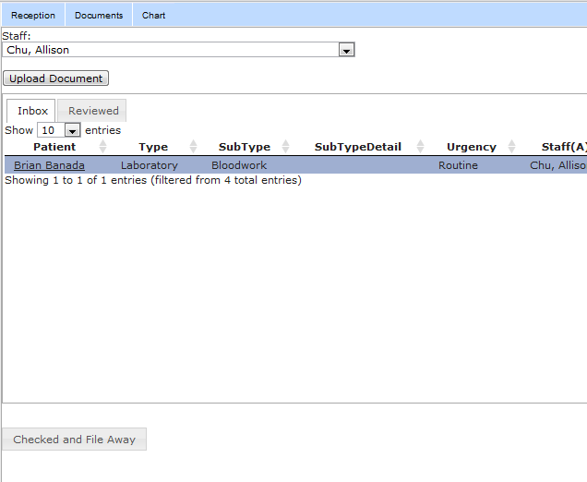
Reviewing Assigned Documents
Click on line to show document on right side.
Documents assigned to you will have a “Checked and File away” button when selected.
After review is complete, click it.

Slide 12
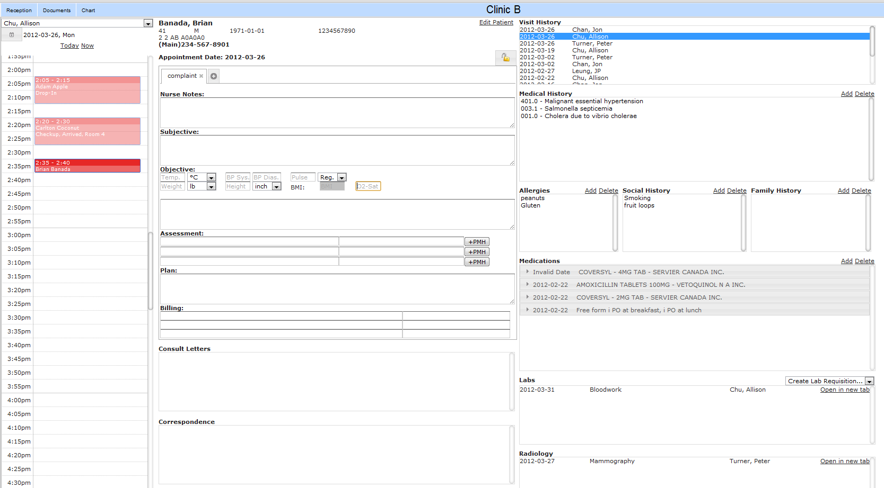
Check and File Away
The doc will be removed from your inbox. But the document will still be attached to patient chart.

Slide 13
Advanced – Adding predefined tags
The app comes with predefined Document Types and their related Sub-types and their related Sub-type Detail.
In a situation where you want to use a tag that is not predefined, click “Add sub-type” or “Add sub-type detail”.

Slide 14
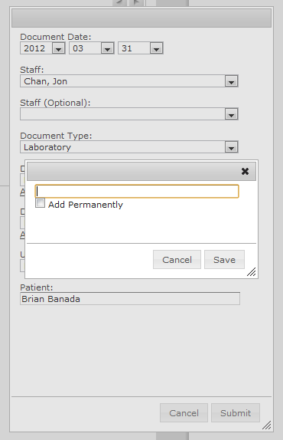
Advanced – Adding predefined tags
You can use the tag just once by typing it in.
If you check “Add Permanently”, the tag will forever be related to the Document Type or Sub-type and appear in the drop down menus when the related Document Type or Sub-type is selected.

Slide 15
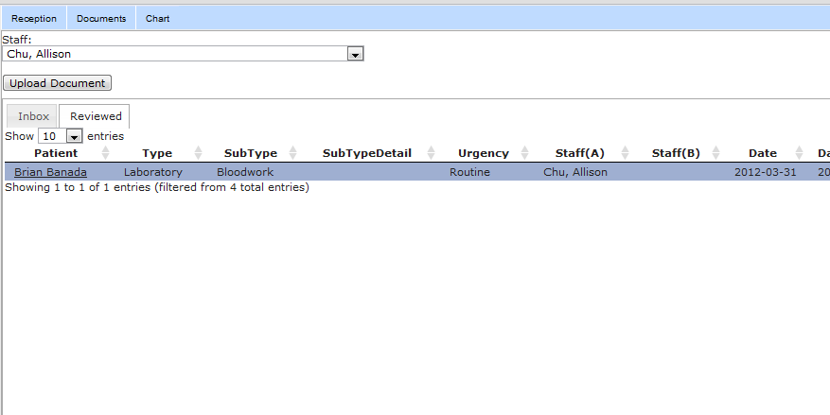
Advanced – Looking at recently reviewed documents
You can see documents you recently Checked and Filed away by clicking the “Reviewed” tab

Slide 16
Questions?

