Slide 1
EMR Training: Appointments
Last updated: Mar 20, 2012

Slide 2
Appointments
Viewing
Scheduling
Scheduling Drop in Patients
Modifying Appointments
Cancelling
Moving an Appointment
Copying
Advanced

Slide 3
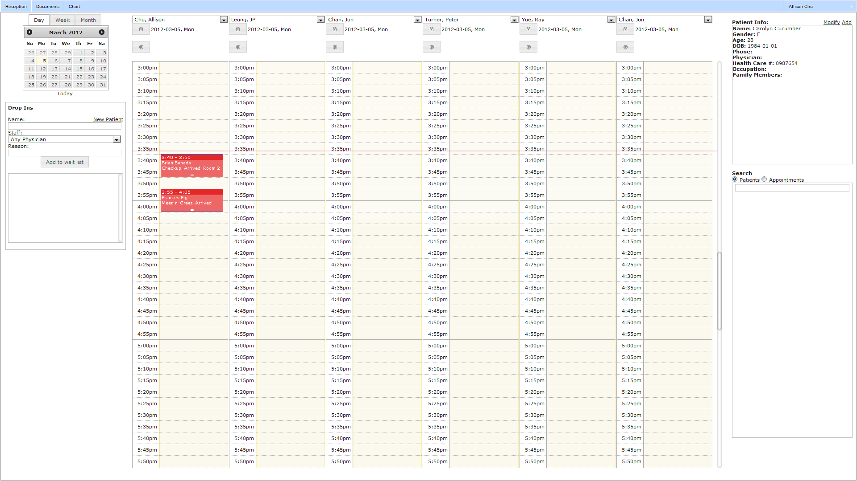
Viewing Appointments
Reception Tab
  Shows date of schedule
  Yellow box shows current day

Slide 4
Viewing Appointments
Reception Tab
  Red line shows current time
  Appointments
  show up as blocks

Slide 5
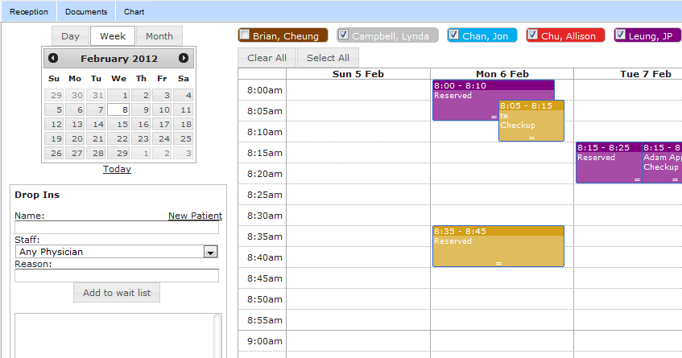
Viewing Appointments - Views
Day View
Week View
Click today to go to the current day

Slide 6
Viewing Appointments - Staff
Day View
  Selecting Staff
Week View
  Filtering Staff

Slide 7

Scheduling Appointments
Reception tab
Select a staff member
Double click on day schedule timeslot or
Right click and select “Add Appointment…”

Slide 8
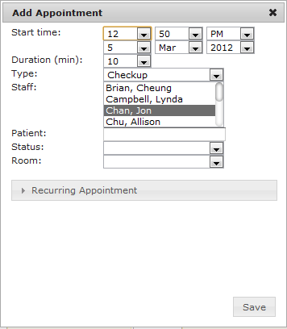
Add Appointment
Modify the start time
Modify the duration
Select type
Choose staff

Slide 9
Add Appointment
Select patient
  Typing will start auto complete.
Select status
Choose a room
Click Save

Slide 10
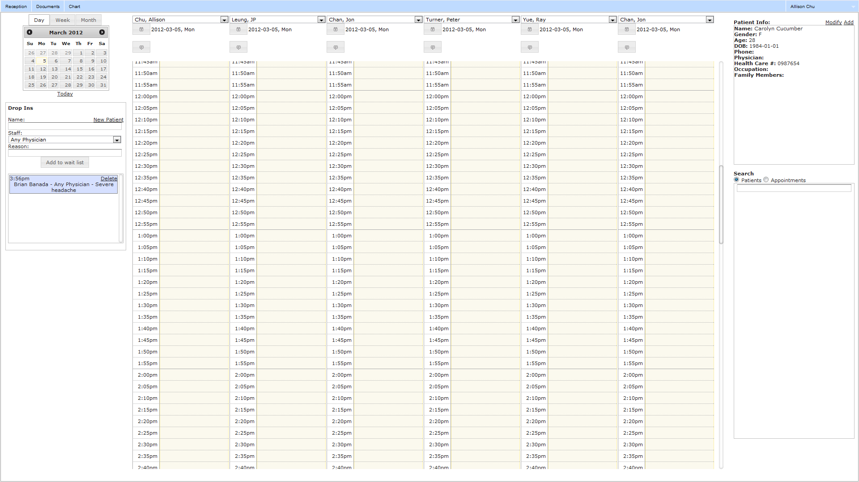
Scheduling Drop in Patients
Create a new patient or
Select patient.
  Start typing for auto complete
Select a staff member or “Any Physician”.
Add the reason for the appointment.
Click “Add to wait list”.

Slide 11
Scheduling Drop in Patients
When the patient is ready to be seen, drag item from wait list into any day schedule

Slide 12
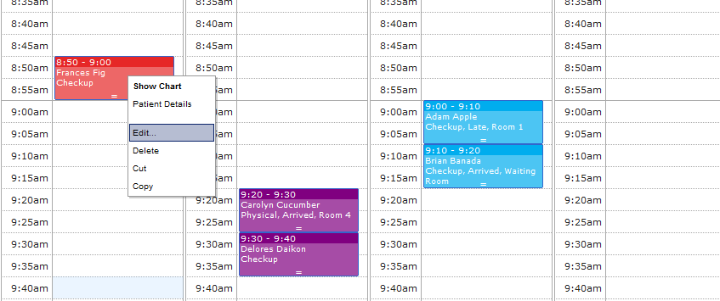
Modifying Appointments
Right click on appointment
Select “Edit”

Slide 13
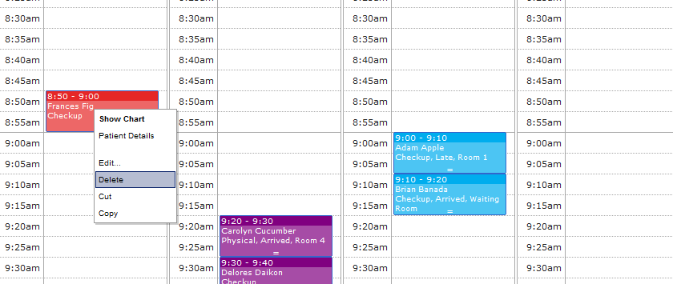
Cancelling Appointments
Right click on appointment
Select “Delete”

Slide 14
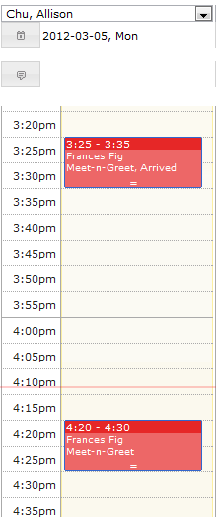
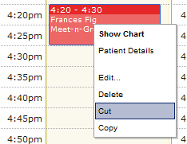
Moving Appointments
You can “drag and drop” the appointment (if it is within the same day and staff member)
or Right click an appointment and select “Cut”. Go to destination and
right click “Paste”

Slide 15
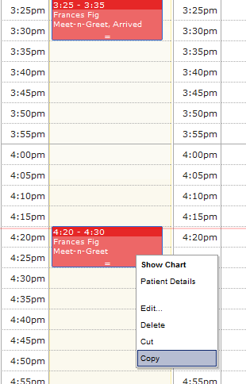
Copying an Appointment
You can copy an existing appointment to save time when rescheduling a patient
Simply right click a timeslot and “Paste” it into the destination date

Slide 16
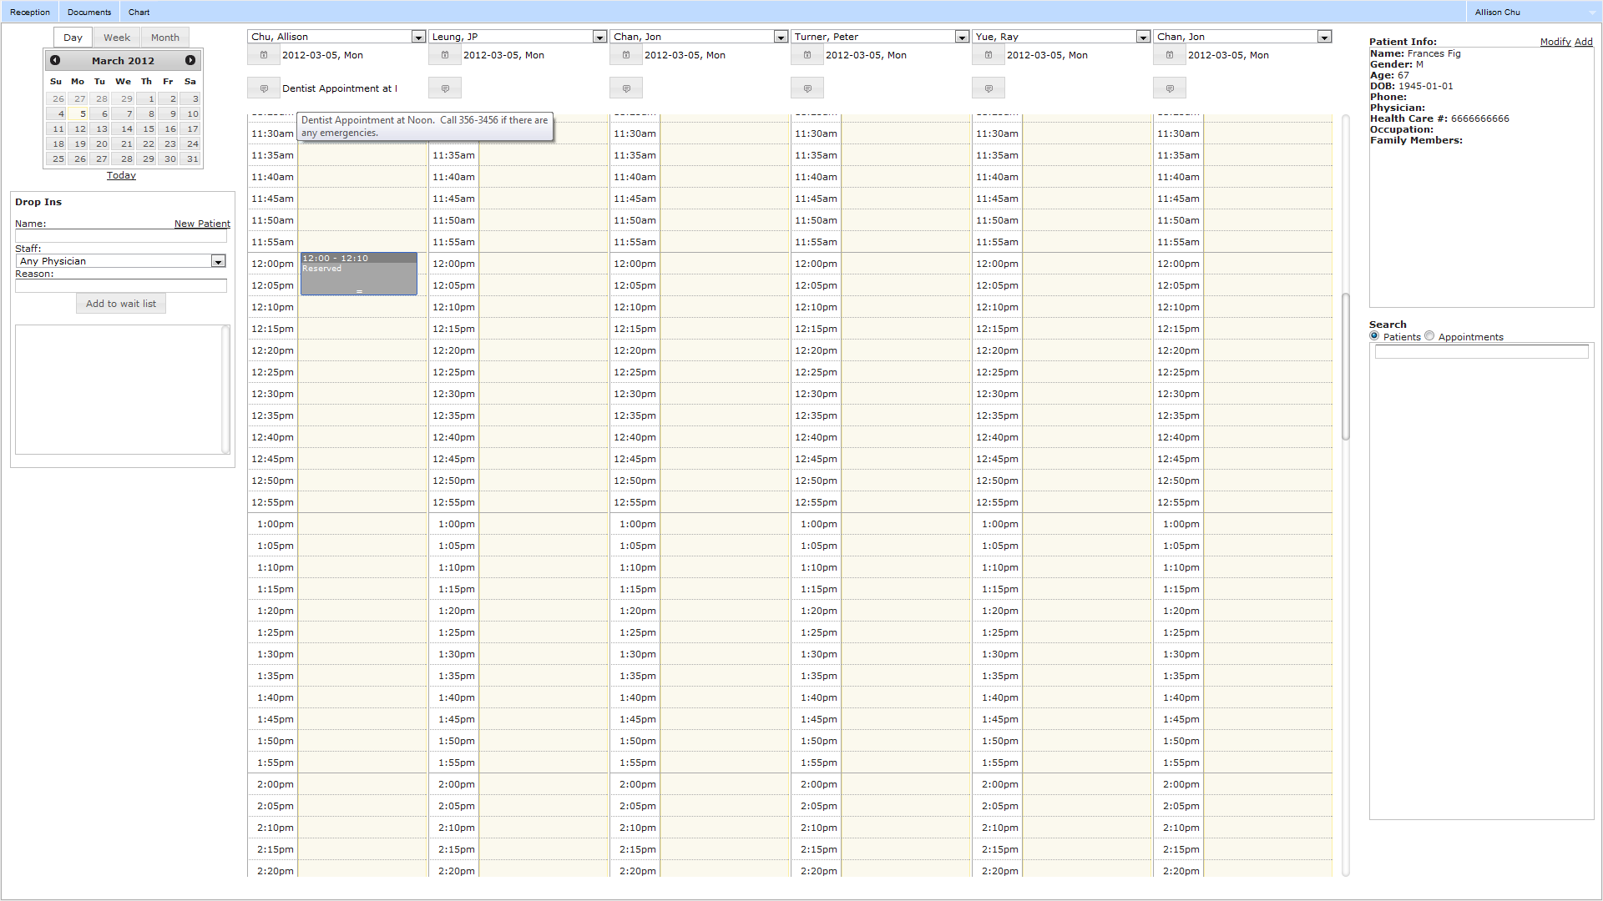
Advanced Scheduling – Day Notes
Add day notes
Mouse over to
see full note

Slide 17
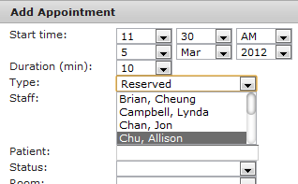
Advanced Scheduling - Reserve
You can reserve a time slot
by “creating an appointment” and selecting “Reserved” from the type field

Slide 18
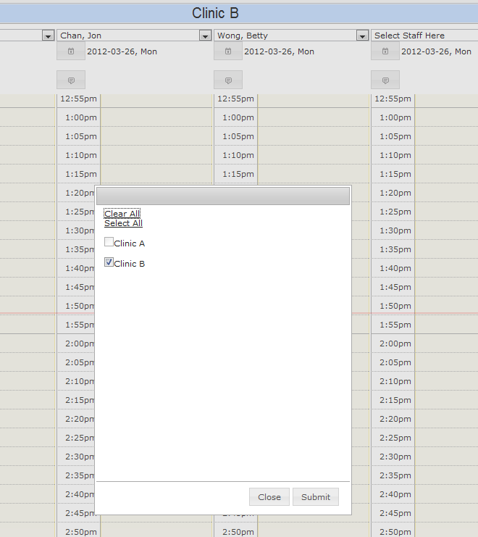
Advanced Scheduling
You can select a different clinic (or multiple clinics)
Click the title bar to select
All scheduling actions will be specific to the clinics you have selected.
Ex) Doctor list, patient list

Slide 19
Questions?

